Slide 1
Noise Lab
Felix Martinez
Partners: Nathan Valdez, Seth Hall
Notes:
My Name is Felix Martinez, my presentation is over Lab 10, The Noise Lab
My partners for this lab were Nathan Valdez and Seth Hall

Slide 2
Abstract
Resistor Noise
Johnson-Nyquist noise (White noise)
1/f noise (Pink noise)
Shot noise (White noise)
Notes:
This lab is set up into 3 total Experiments falling into two different Experimental Setups
For the Resistor Noise Setup, we will be working with Johnson-Nyquist Noise (a type of white noise) and 1/f Noise (Pink noise)
Shot Noise, another type of white noise, will have a separate setup
White Noise is defined to have a flat spectral density at different frequencies. This is caused by its signal having the same intensity at different frequencies.
Pink Noise has its spectral density inversely proportional to frequency.

Slide 3
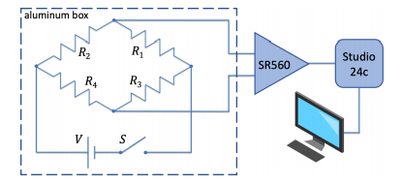
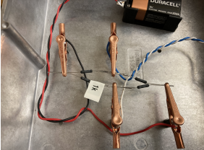
Resistor Noise Setup
Equipment
- Stanford Research Systems SR560 Voltage Preamplifier (SR560)
- PreSonus Studio 24c
- Cuts off frequency below 20 Hz
- “Audacity” software
Credit: George R. Welch Noise Lab Instructions
Johnson-Nyquist Noise
- Wire-wound Resistor Bridges
1/f Noise (Pink Noise)
- Carbon Resistor Bridges
Notes:
The source for our resistor noise is the resistor bridge.
-This is then amplified by our SR560 Pre-amp.
-Then Converted by our PerSonus Studio 24c, our Analog to Digital Converter (blocks of freq below ~20 Hz)
-Then feeds into our Computer running Audacity Software
Johnson-Nyquist Noise will use Wire-wound resistor bridges (0.5, 1.0, 2.0 KOhm)
These wire-wound are chosen as they are high-quality resistors, removing Pink noise at lower frequencies
Pink Noise will use Carbon Resistors
These are less high-quality and the carbon elements suffer from pink noise

Slide 4
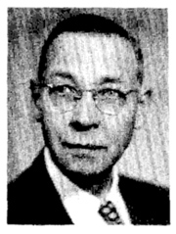
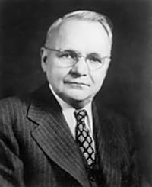
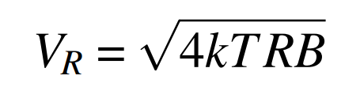
Johnson-Nyquist Noise
Also Known as Thermal Noise.
Occurs from random motion of free electrons. This motion causes a random current and then a random noise.
Magnitude of said Noise is proportional to temperature and the conductor.
Spectral Density plots have a flat spectral density up to a maximum frequency related to the collision time of electrons.
The relationship between Resistance
and Johnson-Nyquist Noise:
Discovered by J.B. Johnson in 1926
Derived by Harry Nyquist later that year
Notes:
Occurs from the random motion of free electrons, this motion causes a random current and then a random noise.
The magnitude of said noise is proportional to the temperature of the conductor
Johnson-Nyquist Noise Spectral Density plots have a flat spectral Density up to a maximum frequency, this freq cutoff is related to the collision time of electrons.
V_R = Johnson Nyquist Noise Spectral Density
K = Boltzman Constant
T = Temp in Kelvin
R = Resistance
B = Bandwitdh Frequency

Slide 5
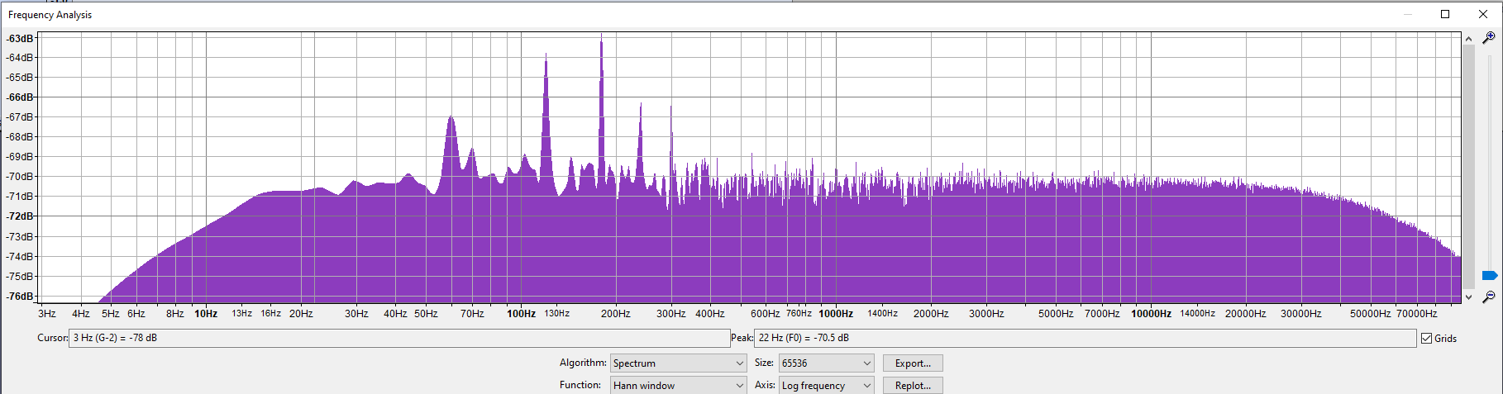
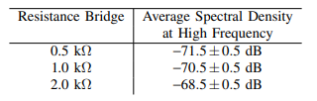
Johnson-Nyquist Noise Results
1.0 kΩ Wire-wound Spectral Density Plot
- The Peaks at every multiple of 60Hz result from background Noise from AC Power supply.
Notes:
When conducting this experiment we encountered a lot more noise than is shown.
We were able to locate where the problem originated to our Pre-amp being plugged into the wall, suffering from AC current noise.
We unplugged it for battery power operation, steading our noise for lower frequency.
We still get spikes at frequencies that are multiples of 60Hz due to our Analog-Digital-Converter and the computer we use still plugged into the wall.
Error in the Average spectral Density at High freq is from measuring by eye, we could have fixed this by saving our data individually instead of taking screenshots

Slide 6
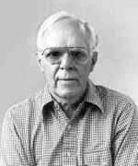
1/f Noise (Pink Noise)
Also Known as Flicker Noise
Related to a direct current as resistance fluctuations are transformed to voltage by Ohms law.
Seems to be no lower limit yet there is an upper limit where Pink Noise collides with Johnson-Nyquist Noise.
There is no known cause of Pink Noise.
Discovered by Martin Gardner in 1978
Notes:
Pink Noise is usually related to a DC current as resistance fluctuations are transformed to voltage or current fluctuations by Ohms law
An interesting property of 1/f noise is there seems to be no lower limit yet there is an upper limit.
This upper limit lies where the decreasing pink noise collides with that of Johnson-Nyquist noise where is then maintained for higher frequencies past this cutoff.
There is no known cause of Pink Noise.

Slide 7
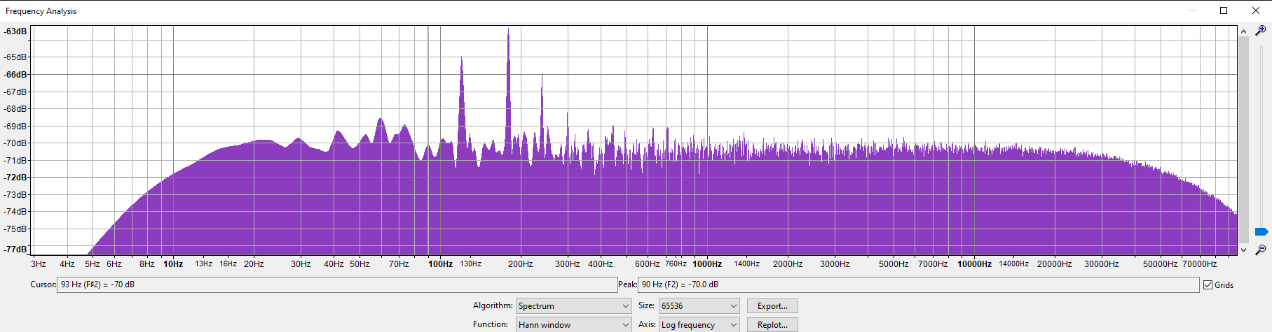
Pink Noise Results
1.0 kΩ Carbon Wired Spectral Density Plot Voltage Off
Carbon Wired Resistors hold the same Johnson-Nyquist Noise Relation as our Wire-wound Resistors.
Notes:
Carbon wired resistors have the same Johnson-Nyquist Noise as the wire-wound resistors.
This will come in handy when being able to determine the Johnson-Nyquist Noise overtaken frequency from Pink Noise

Slide 8
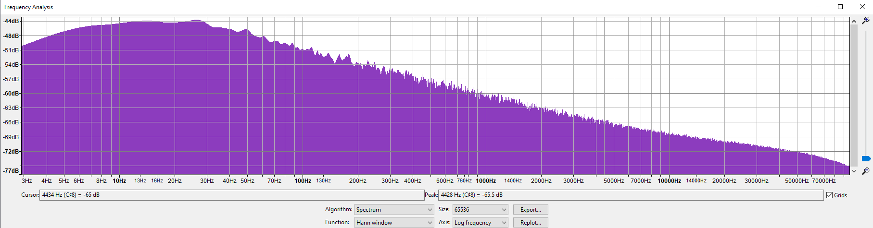
Pink Noise Results
0.5 kΩ Carbon Wired Spectral Density Plot
Peak Spectral Density: -43.5 ± 0.5 dB
Notes:
This Peak at 20 Hz is caused by our Analog to Digital Converter blocking off frequencies below around 20 Hz.
This Diminishes power at lower Frequencies.

Slide 9
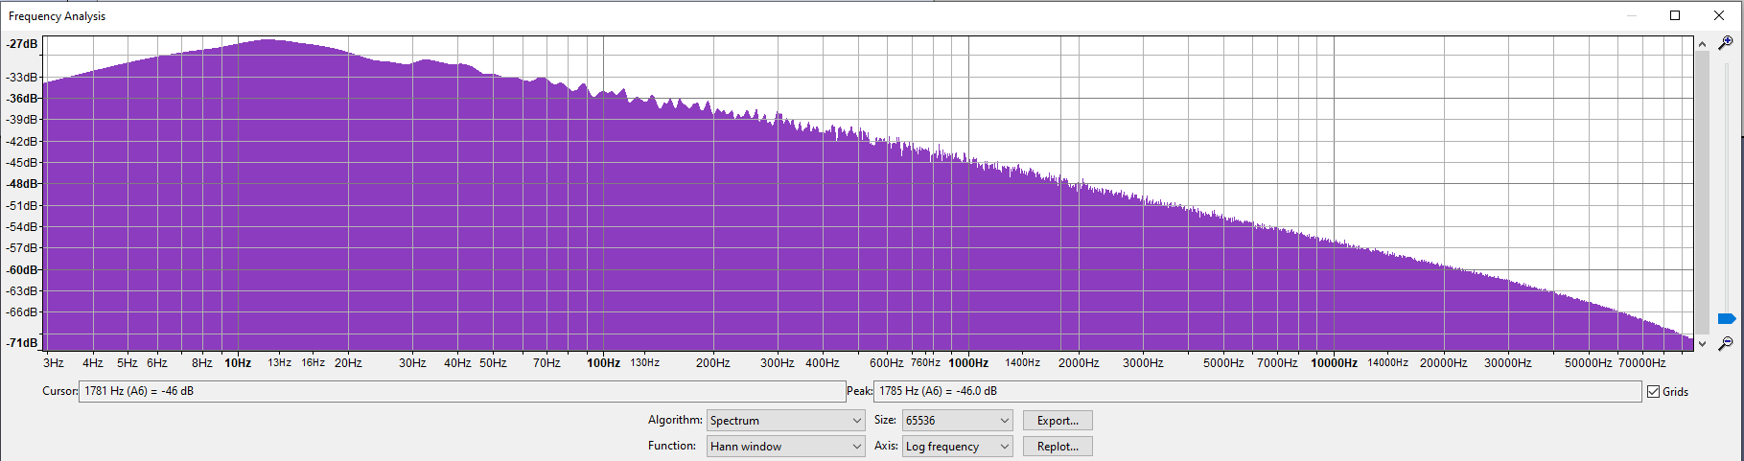
Pink Noise Results
1.0 kΩ Carbon Wired Spectral Density Plot
Peak Spectral Density: -27.5 ± 0.5 dB

Slide 10
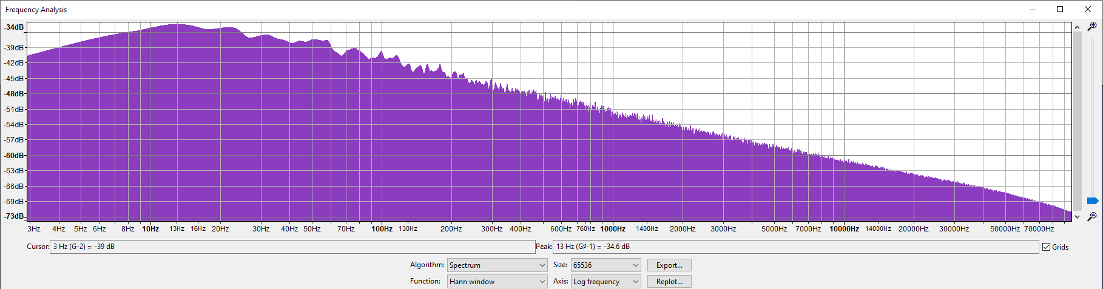
Pink Noise Results
2.0 kΩ Carbon Wired Spectral Density Plot
Peak Spectral Density: -34.5 ± 0.5 dB

Slide 11
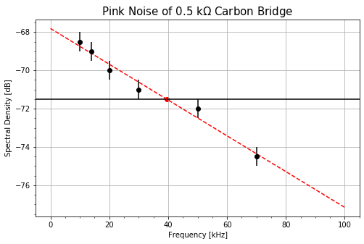
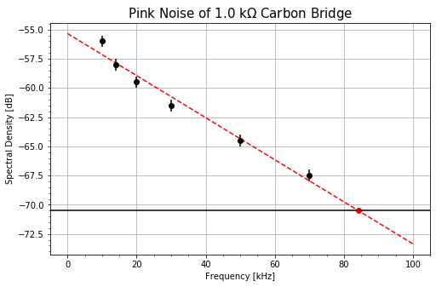
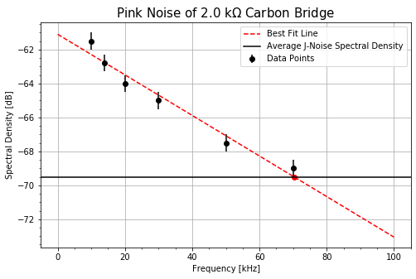
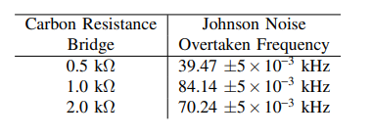
Pink Noise Results
Carbon Wired Data plots
Our Johnson-Nyquist Noise overtaken frequency changes with resistance, however it does not follow an expected relationship.
Notes:
We measured data points at 10, 14, 20, 30, 50, and 70 kHz by eye due to us not downloading the data the error bars of 0.5 dB continue,
We also chose the black horizontal lines to be the average Johnson-Nyquist Noise Spectral Density at high frequencies which we determined in the first experiment.
We then plotted a best fit line to find the overlapping point between this and our high frequency Johnson-Nyquist noise.
This overtaken frequency does not follow an expected relationship of increased resistance resulting in an increased frequency.

Slide 12
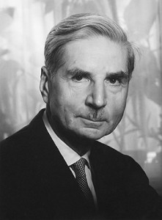
Shot Noise
Also known as Poisson Noise
Results from discrete nature of electric charge in a DC current.
Temperature Independent.
Shot noise is flat, resulting in its noise spectral density being independent of frequency.
Breaks down at both very low and high frequencies.
Discovered by Walter Schottky in 1918
Notes:
Shot Noise results from Discrete Nature of electric charge in a DC Current
Unlike Johnson Noise, Shot Noise is temperature independent
Shot noise is flat, resulting in its noise spectral density being independent of frequency
This flatness causes Shot noise to break down at both very low and very high frequency where the statistics of the arrival time of the electrons deviates from Poissonian

Slide 13
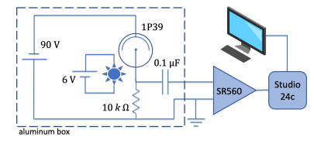
Shot Noise Setup
Illuminate a 1P39 Vacuum photo-diode with light.
Due to the vacuum tubes having strange noise characteristics at low frequencies.
We will conduct this experiment by changing the current feeding our circuit.
We will have to throw out frequencies below a few hundred Hertz.
Notes:
We will illuminate a 1P39 vacuum photo-diode with light powered by a 6V battery.
The current produced by the photo-diode will flow through the resistor producing a voltage that should be constant in the absence of noise
Much like for Johnson-Nyquist noise, we will extract the AC component of this using our SR560 pre-amp
Then Converted it using our Studio 24c Analog to Digital Converter
Then feeds into our Computer running Audacity Software
We will conduct this experiment by changing the current feeding our cuircuit from 20 microA to 10 microAmps
Vacuum tubes have strange noise characteristics at low frequencies
Due to this we will have to throw out frequencies below around a few hundred Hertz

Slide 14
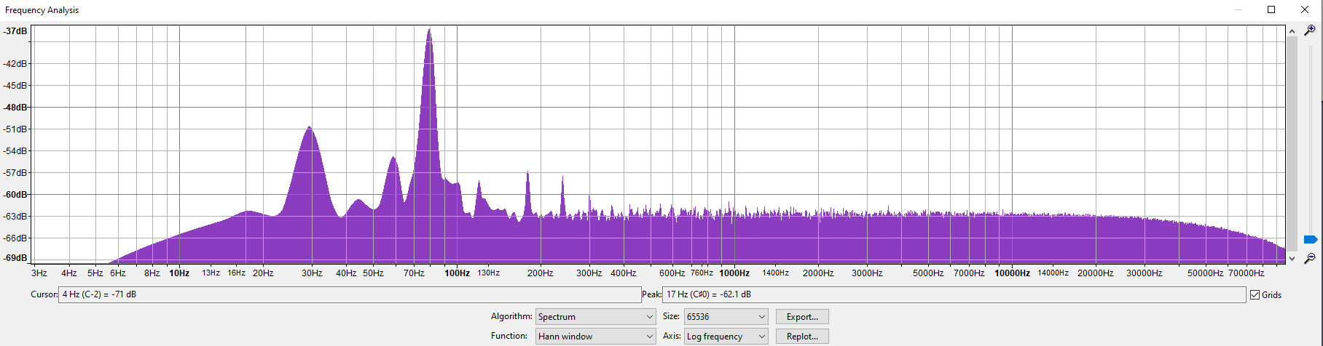
Shot Noise Results
Spectral Density Plot with no current.
Frequencies below ~200 Hz fall apart, while frequencies above this point hold a flat Spectral Density.
Notes:
As described in our Setup, frequencies below a few hundred hertz fluctuate a lot so we will throw out any data above around 200 Hz

Slide 15
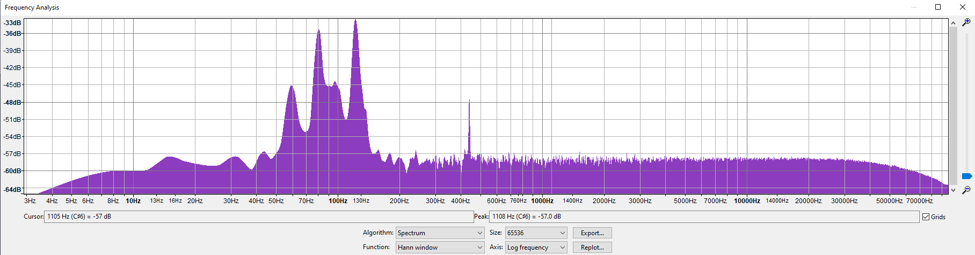
Shot Noise Results
Shot Noise 10.0 µA
Strange Occurrence: 450 ± 5 Hz
Peak: -47.9 ± 0.5 dB

Slide 16
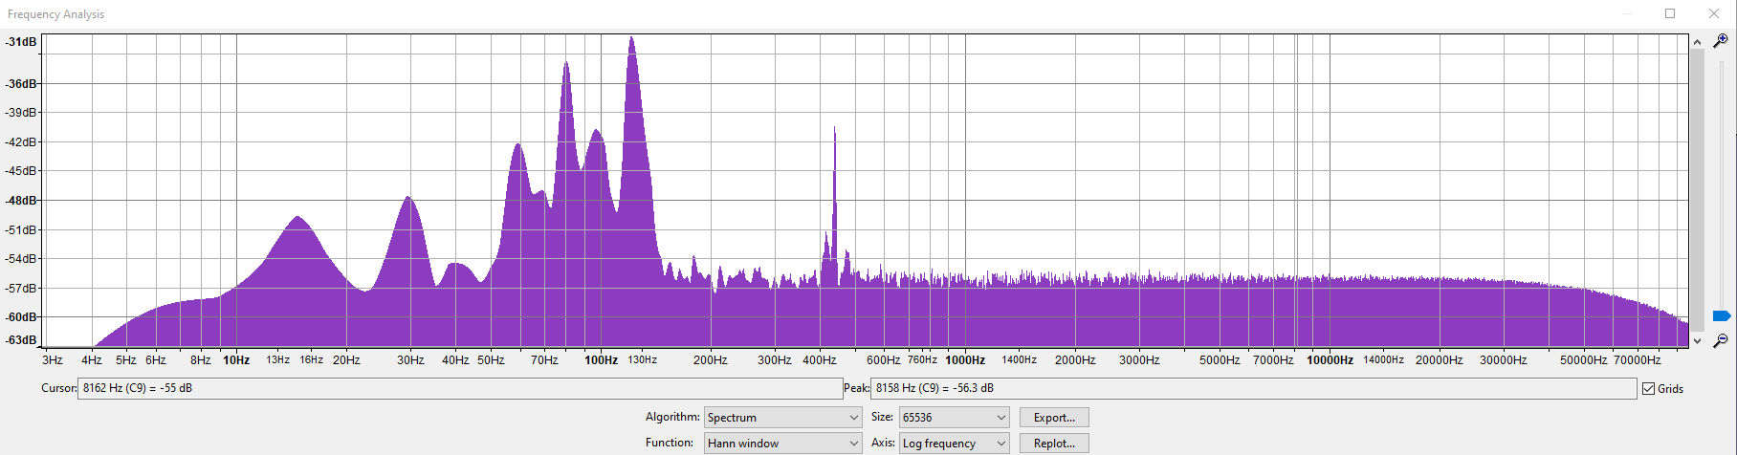
Shot Noise Results
Shot Noise 19.5 µA
Strange Occurrence: 450 ± 5 Hz
Peak: -41.1 ± 0.5 dB
Notes:
The Amplitude scales as we increase our current,
We can say that the spike is not outside interference, but instead a property of our circuit.
However, we were unable to determine it.

Slide 17
Conclusion
Resistor Noise
Johnson-Nyquist Noise Spectral Density at High frequency Scales with Resistance
Possible Improvements.
Shot Noise
Strange phenomenon at 450Hz caused by the circuit.
Questions?
Notes:
In Conclusion, Johnson-Nyquist Noise Spectral Density at High frequency scales with Resistance.
We believe the Resistor Noise experiment could be improved upon by increasing the number of resistor bridges at a wider range.
This could allow for us to try and determine a relationship between Resistance and Johnson-Nyquist Noise overtaken frequency.
Furthermore, our Shot Noise had a phenomenon that occurred at ~450Hz that we were unable to determine the cause of. With that, we were still able to narrow it down to residing within our circuit due to the amplitude scaling with current.

Slide 18
References
Noise Lab Instructions, George R. Welch
W. Schottky, Annalen der Physik 362, 541-567
https://en.wikipedia.org/wiki/Pink_noise
https://en.wikipedia.org/wiki/Johnson%E2%80%93Nyquist_noise
https://en.wikipedia.org/wiki/Shot_noise
Notes:
In Conclusion, Johnson-Nyquist Noise Spectral Density at High frequency scales with Resistance.
We believe the Resistor Noise experiment could be improved upon by increasing the number of resistor bridges at a wider range.
This could allow for us to try and determine a relationship between Resistance and Johnson-Nyquist Noise overtaken frequency.
Furthermore, our Shot Noise had a phenomenon that occurred at ~450Hz that we were unable to determine the cause of. With that, we were still able to narrow it down to residing within our circuit due to the amplitude scaling with current.

